Slide 1


Slide 2
What we’re doing?
We want to use deep learning to make people more secure in their homes.
Face recognition to detect intruders.

Slide 3

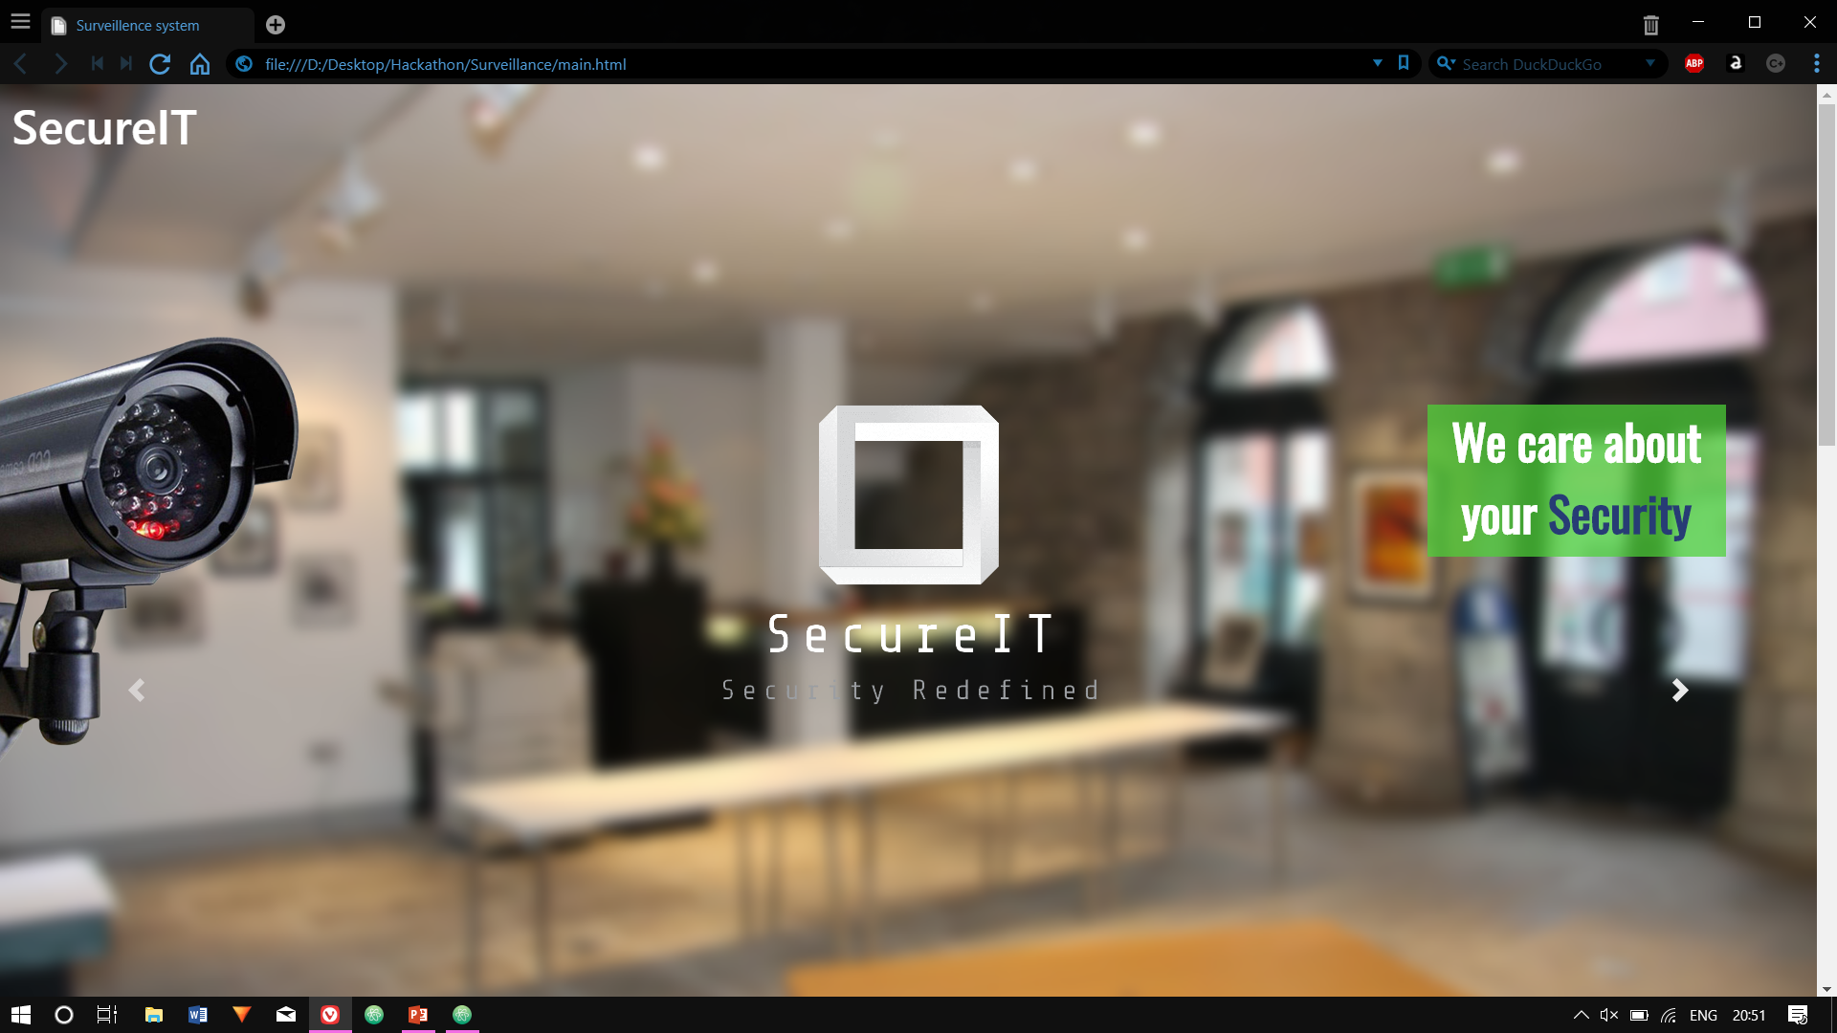

Slide 4
The User can
See through the cameras in real time.
Add family members
Distinguish to find out who’s actually in the frame?

Slide 5
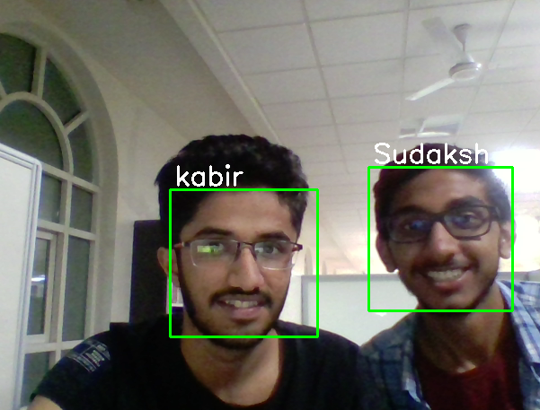
Deep Learning & Computer Vision for Face Recognition

Slide 6
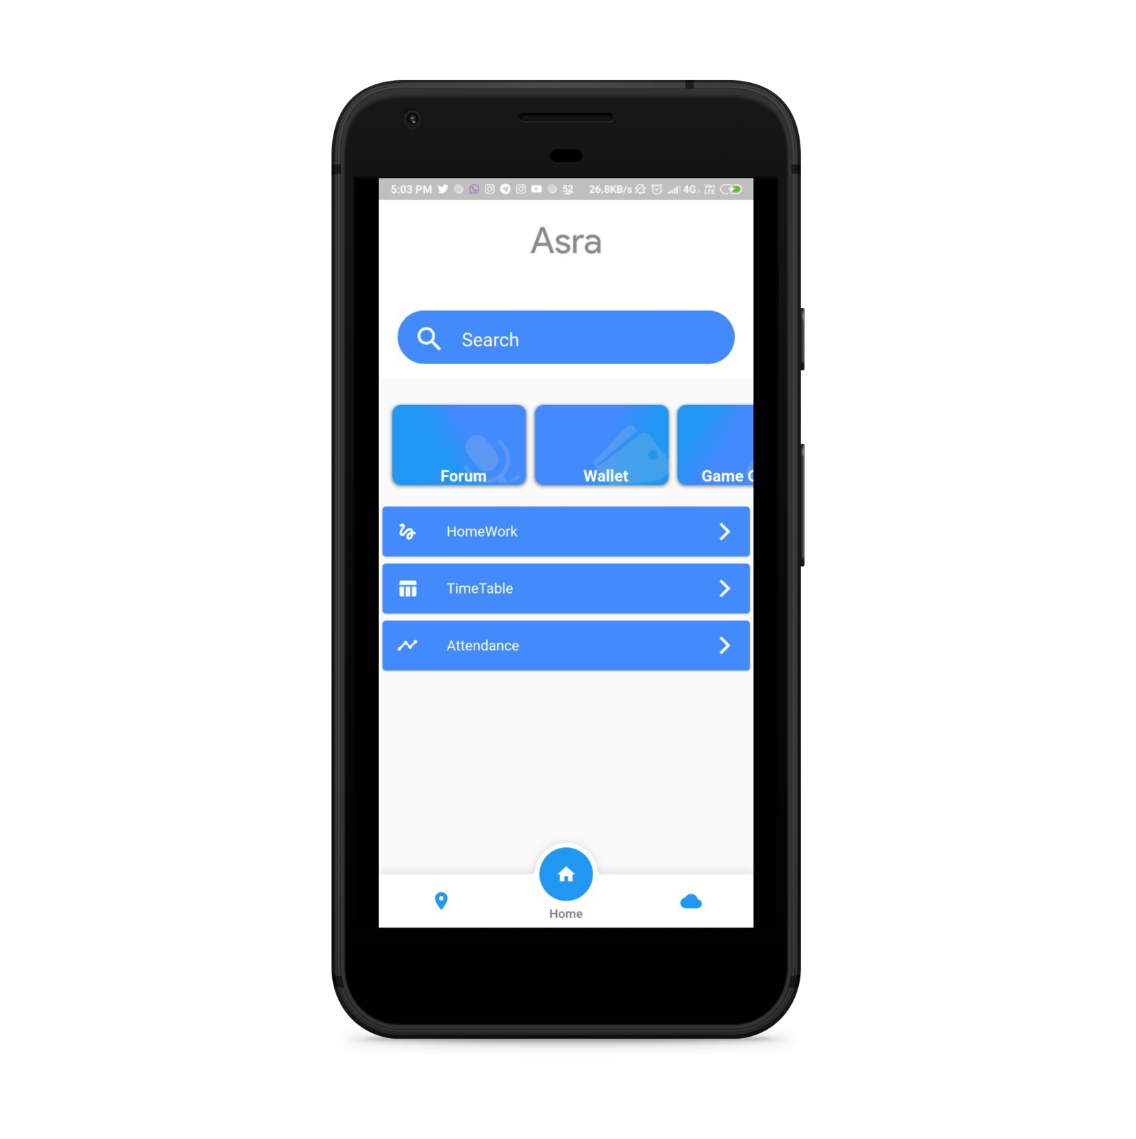

Our Application

Slide 7
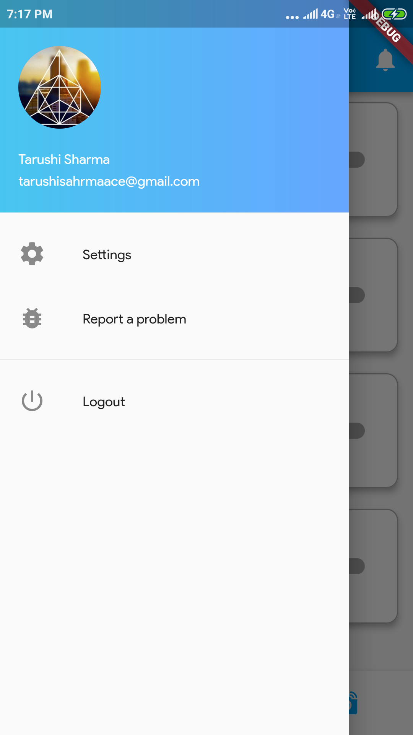
Material UI

Slide 8

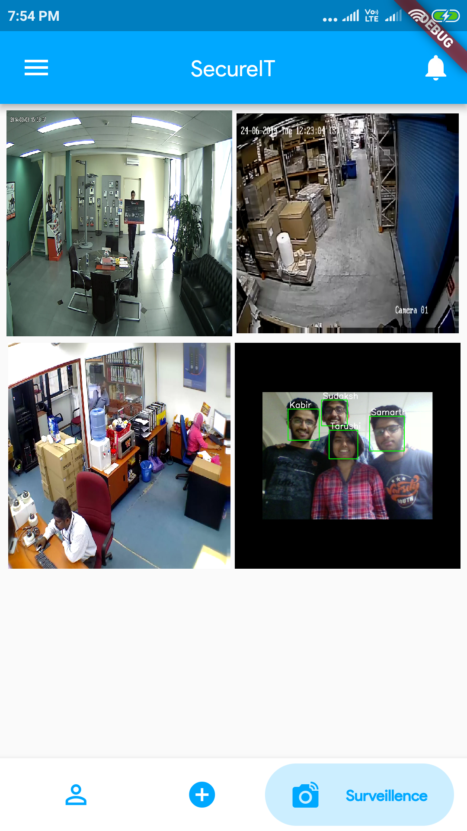
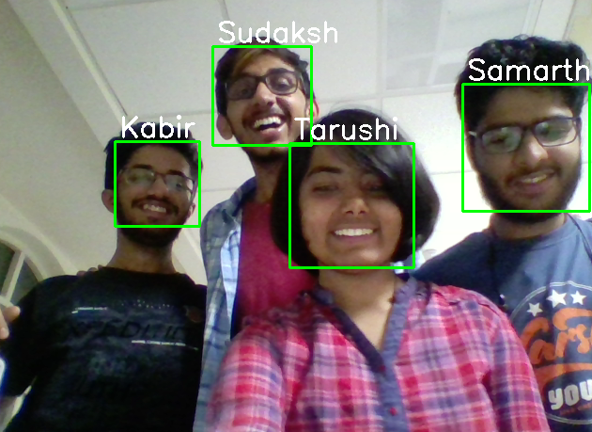
Surveillance

Slide 9
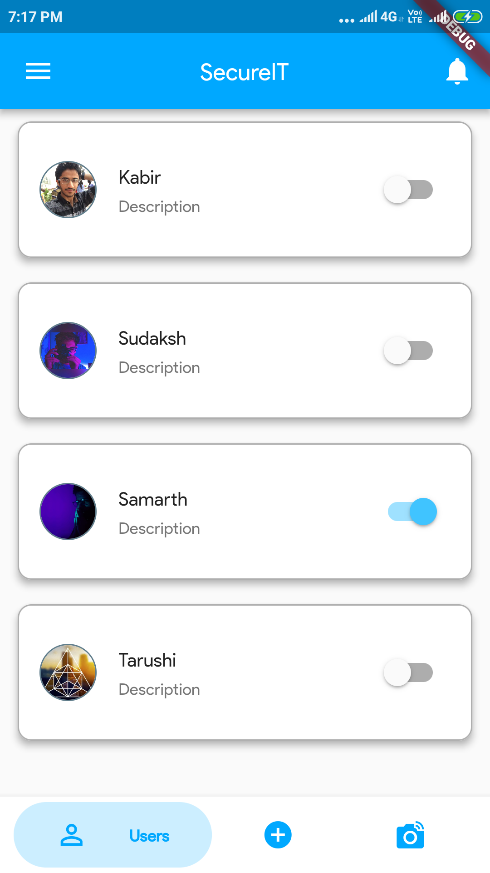
Security

Slide 10
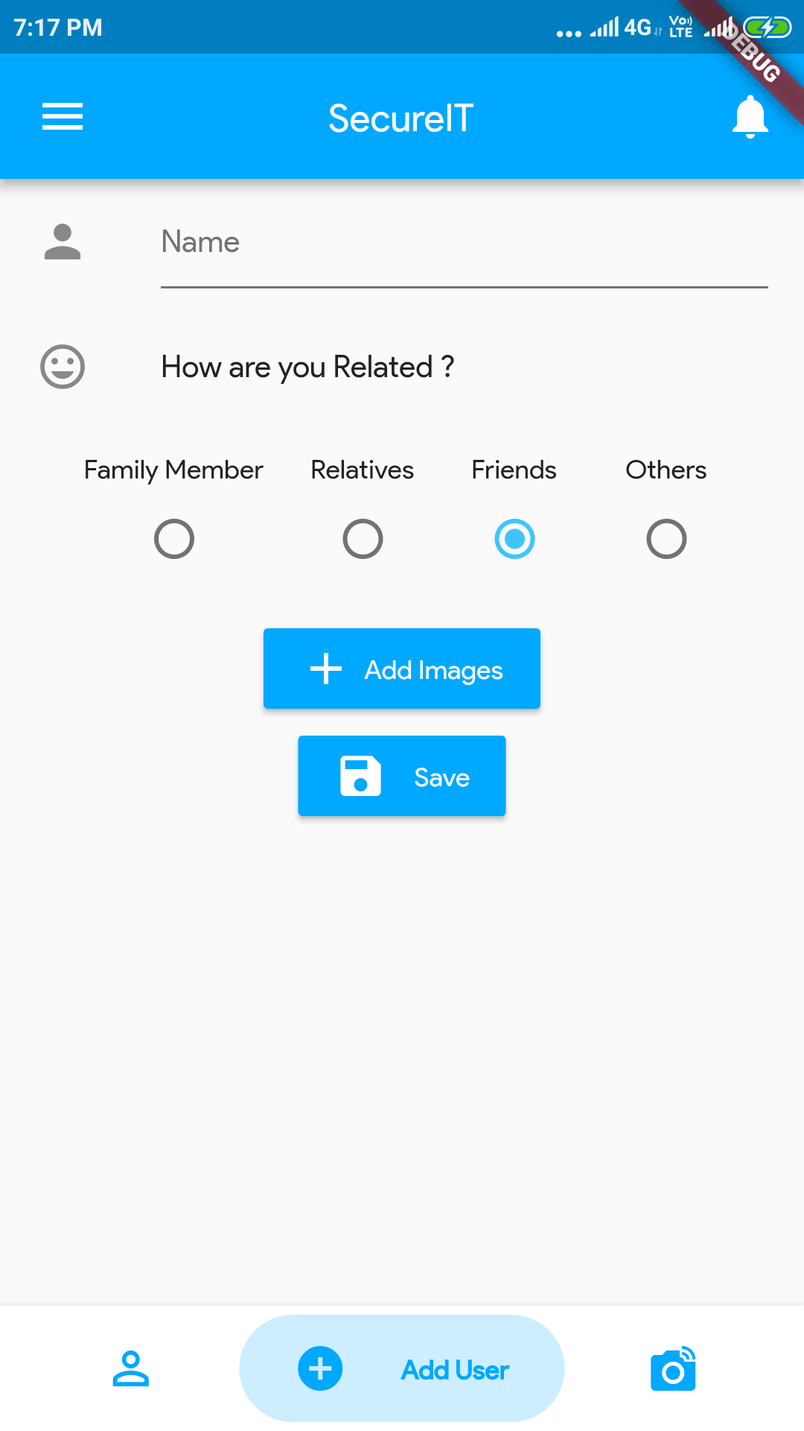
Redefined

Slide 11
Who are we?

